Slide 1
Probabilistic Robotics
Introduction
Probabilities
Bayes rule
Bayes filters

Slide 2
Probabilistic Robotics
Key idea:
Explicit representation of uncertainty using the calculus of probability theory
  Perception = state estimation
  Action = utility optimization

Slide 3

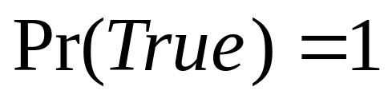
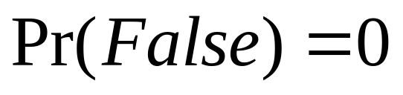
Axioms of Probability Theory
Pr(A) denotes probability that proposition A is true.

Slide 4




A Closer Look at Axiom 3
B

Slide 5
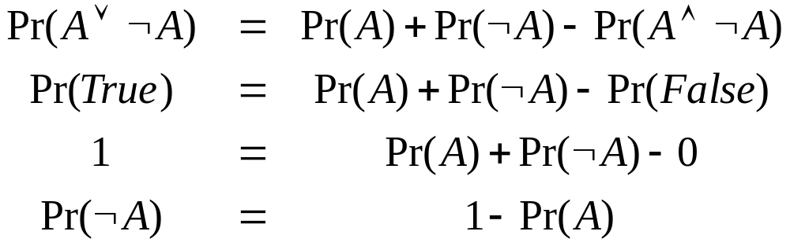
Using the Axioms

Slide 6
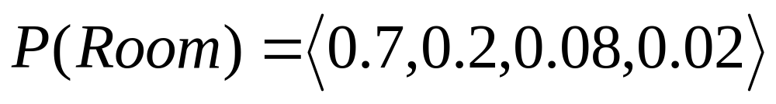
Discrete Random Variables
X denotes a random variable.
X can take on a countable number of values in {x₁, x₂, …, x_{n}}.
P(X=x_{i}), or P(x_{i}), is the probability that the random variable X takes on value x_{i}.
P( ) is called probability mass function.
E.g.
.

Slide 7
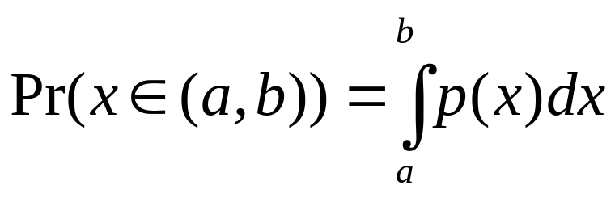
Continuous Random Variables
X takes on values in the continuum.
p(X=x), or p(x), is a probability density function.
E.g.
p(x)
x

Slide 8
Joint and Conditional Probability
P(X=x and Y=y) = P(x,y)
If X and Y are independent then
P(x,y) = P(x) P(y)
P(x | y) is the probability of x given y
P(x | y) = P(x,y) / P(y)
P(x,y) = P(x | y) P(y)
If X and Y are independent then
P(x | y) = P(x)

Slide 9
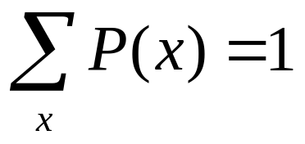
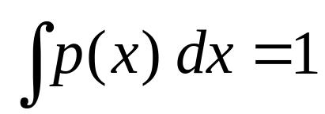
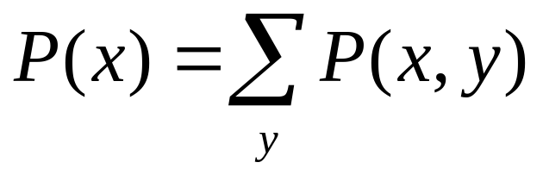
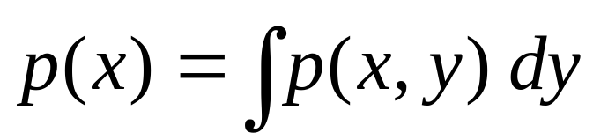
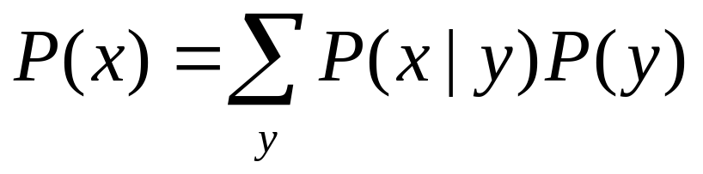
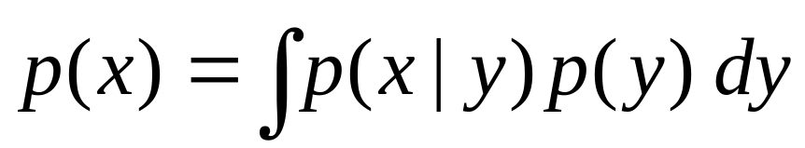
Law of Total Probability, Marginals
Discrete case
Continuous case

Slide 10
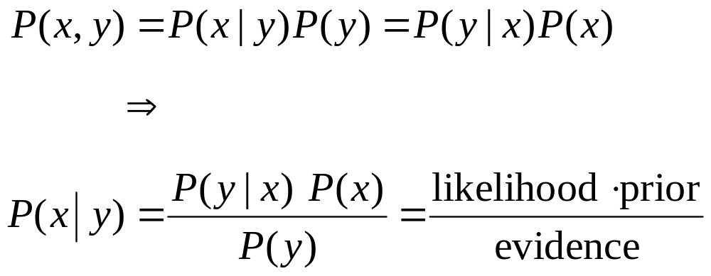
Bayes Formula

Slide 11
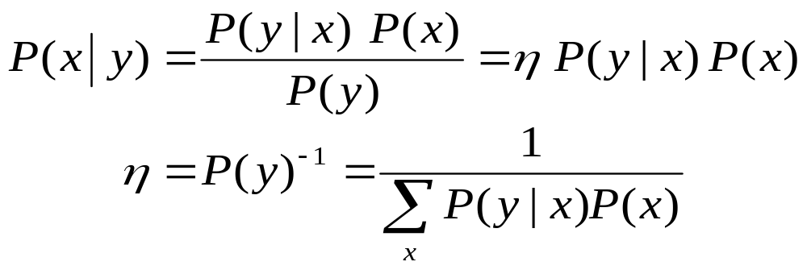
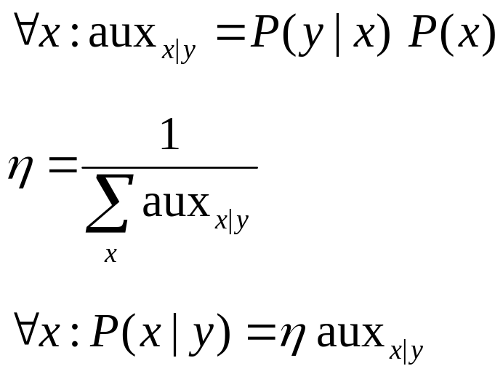
Normalization
Algorithm:

Slide 12
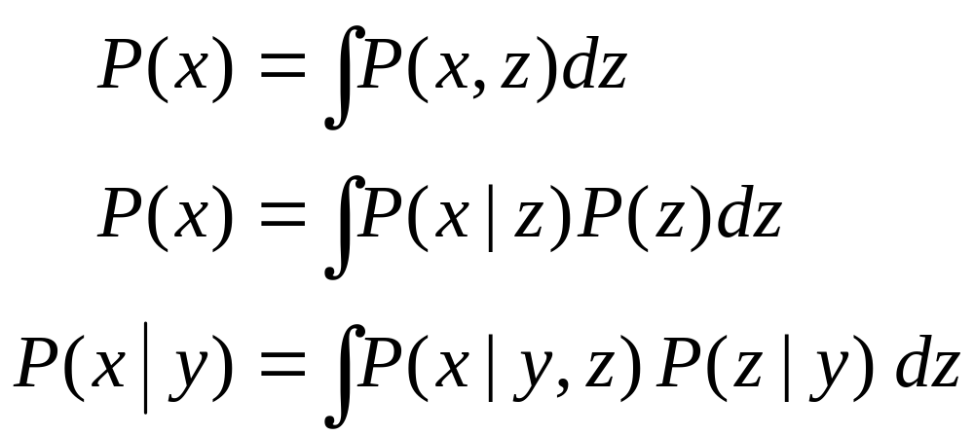
Conditioning
Law of total probability:

Slide 13
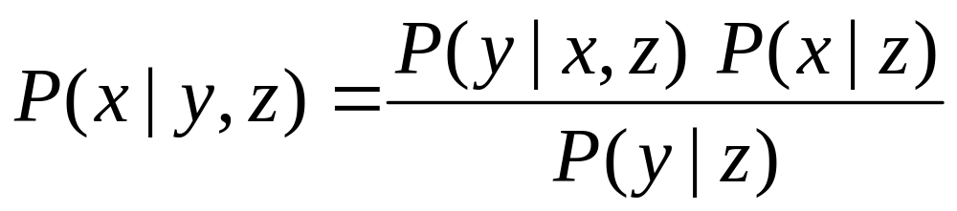
Bayes Rule with Background Knowledge

Slide 14
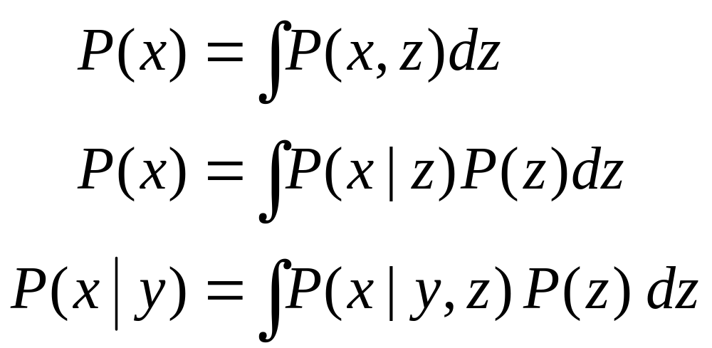
Conditioning
Total probability:

Slide 15
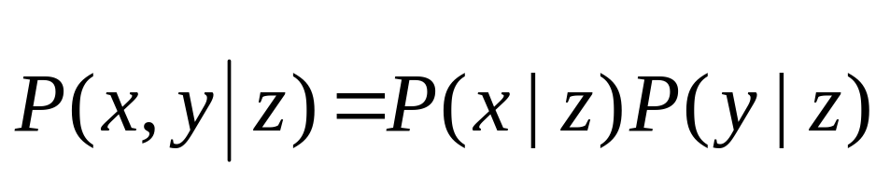
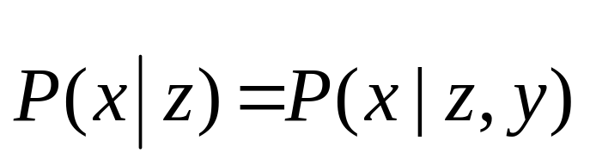
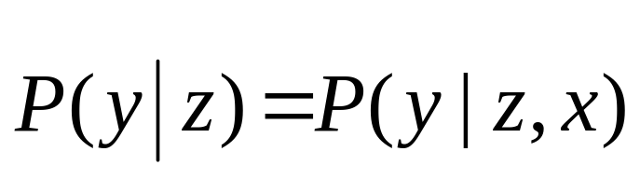
Conditional Independence
equivalent to
and

Slide 16
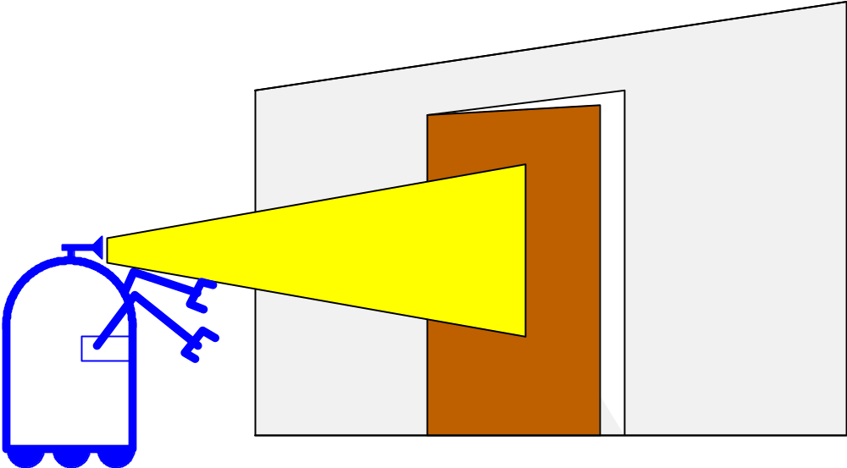
Simple Example of State Estimation
Suppose a robot obtains measurement z
What is P(open|z)?

Slide 17
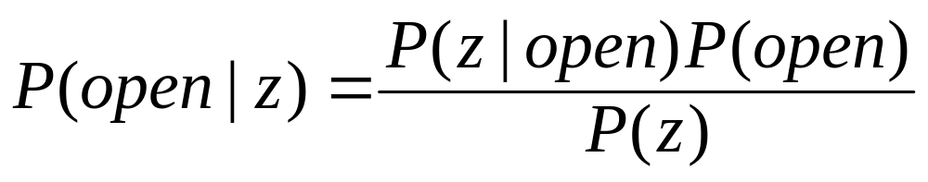
Causal vs. Diagnostic Reasoning
P(open|z) is diagnostic.
P(z|open) is causal.
Often causal knowledge is easier to obtain.
Bayes rule allows us to use causal knowledge:
count frequencies!

Slide 18
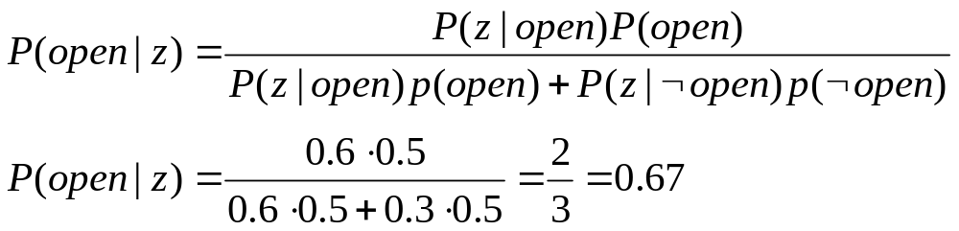
Example
P(z|open) = 0.6 P(z|¬open) = 0.3
P(open) = P(¬open) = 0.5
z raises the probability that the door is open.

Slide 19
Combining Evidence
Suppose our robot obtains another observation z₂.
How can we integrate this new information?
More generally, how can we estimate
P(x| z₁...z_{n} )?

Slide 20
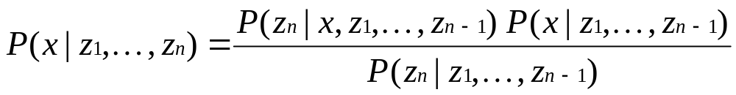
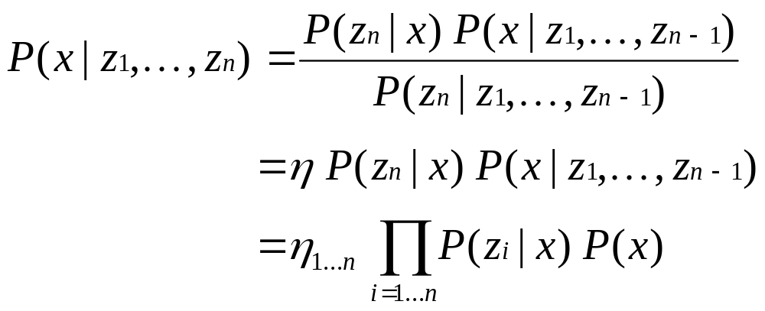
Recursive Bayesian Updating
Markov assumption: z_{n} is independent of z₁,...,z_{n-1} if we know x.

Slide 21
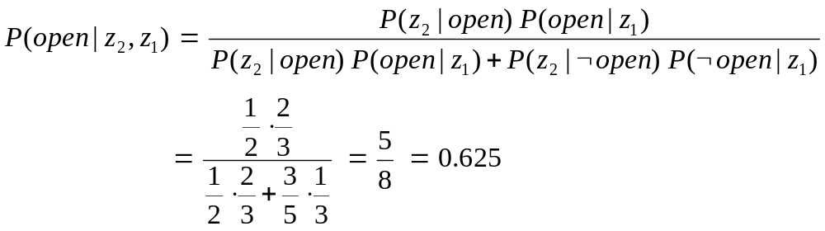
Example: Second Measurement
P(z₂|open) = 0.5 P(z₂|¬open) = 0.6
P(open|z₁)=2/3
z₂ lowers the probability that the door is open.

Slide 22
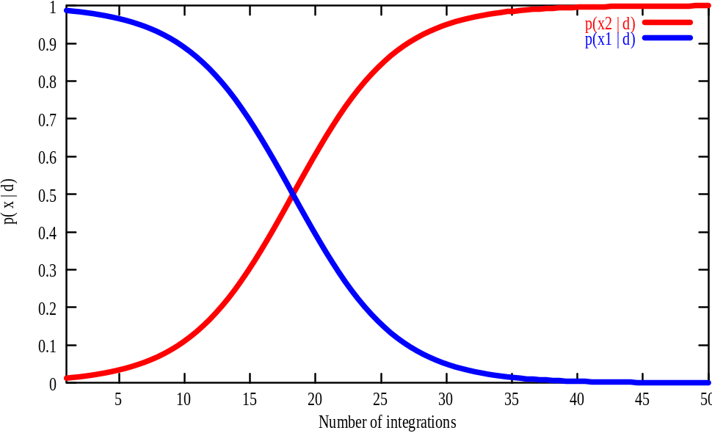
A Typical Pitfall
Two possible locations x₁ and x₂
P(x₁)=0.99
P(z|x₂)=0.09 P(z|x₁)=0.07

Slide 23
Actions
Often the world is dynamic since
  actions carried out by the robot,
  actions carried out by other agents,
  or just the time passing by
change the world.
How can we incorporate such actions?

Slide 24
Typical Actions
The robot turns its wheels to move
The robot uses its manipulator to grasp an object
Plants grow over time…
Actions are never carried out with absolute certainty.
In contrast to measurements, actions generally increase the uncertainty.

Slide 25
Modeling Actions
To incorporate the outcome of an action u into the current “belief”, we use the conditional pdf
P(x|u,x’)
This term specifies the pdf that executing u changes the state from x’ to x.

Slide 26
Example: Closing the door

Slide 27
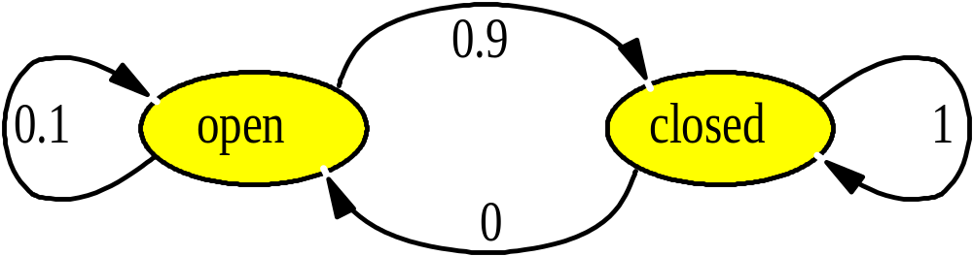
State Transitions
P(x|u,x’) for u = “close door”:
If the door is open, the action “close door” succeeds in 90% of all cases.

Slide 28
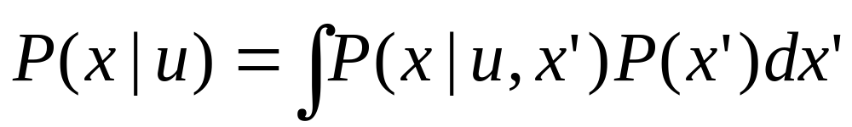
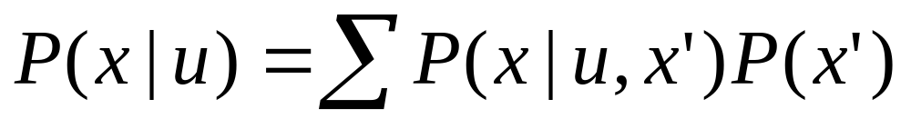
Integrating the Outcome of Actions
Continuous case:
Discrete case:

Slide 29
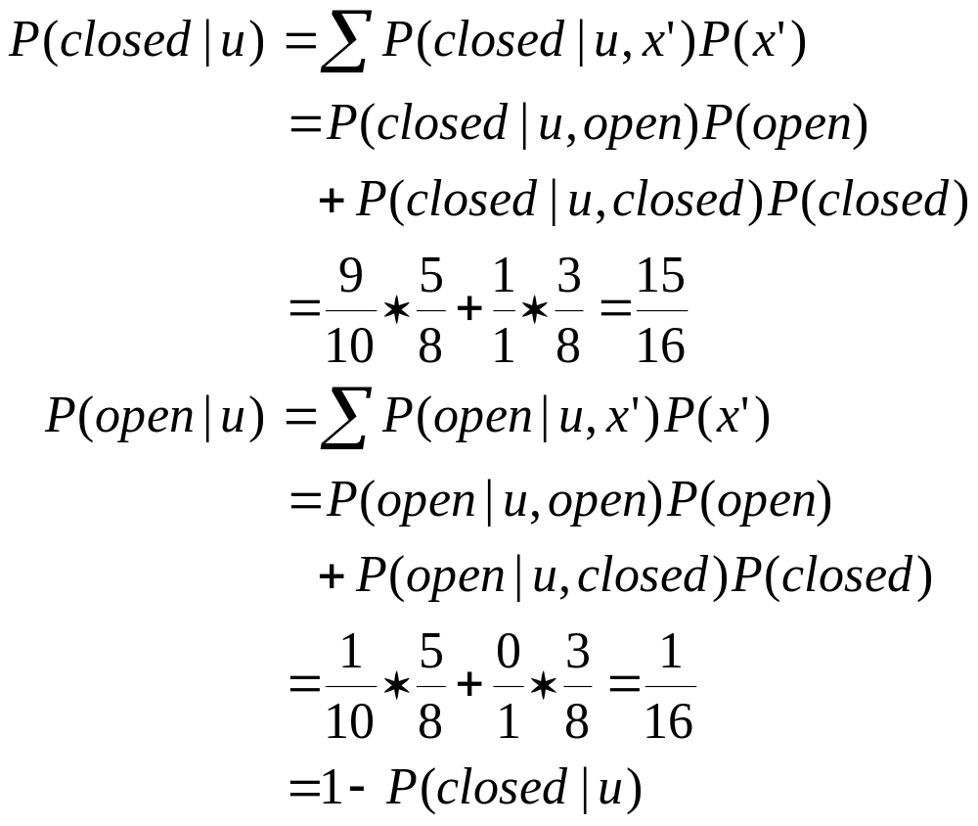
Example: The Resulting Belief

Slide 30
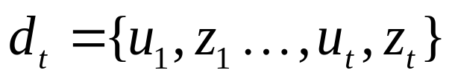
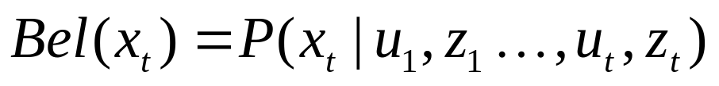
Bayes Filters: Framework
Given:
  Stream of observations z and action data u:
  Sensor model P(z|x).
  Action model P(x|u,x’).
  Prior probability of the system state P(x).
Wanted:
  Estimate of the state X of a dynamical system.
  The posterior of the state is also called Belief:

Slide 31
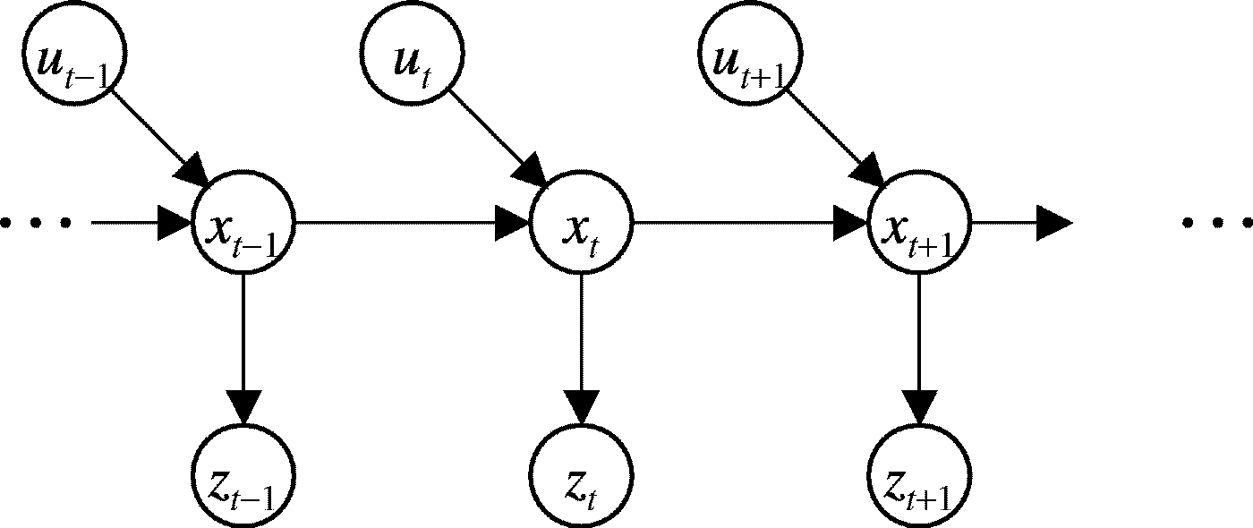
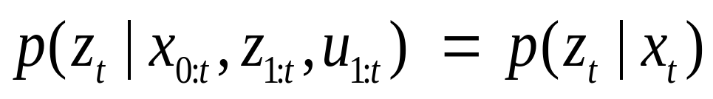
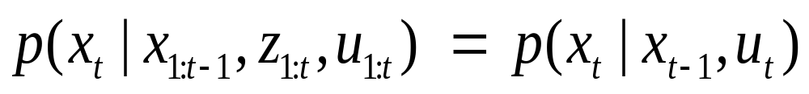
Markov Assumption
Underlying Assumptions
Static world
Independent noise
Perfect model, no approximation errors

Slide 32

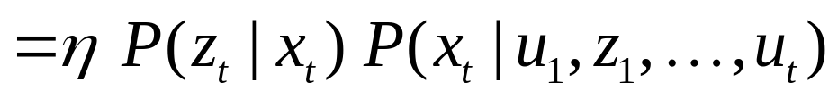
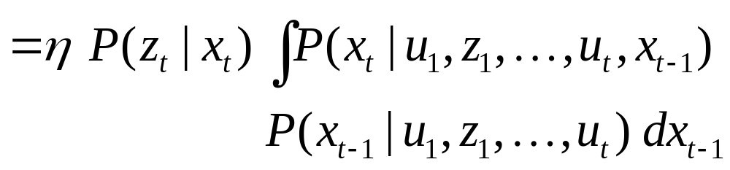
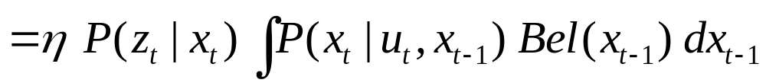
Bayes Filters
z = observation
u = action
x = state
Bayes
Markov
Total prob.
Markov
Markov

Slide 33



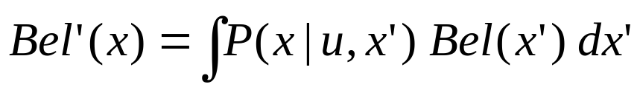
Bayes Filter Algorithm
Algorithm Bayes_filter( Bel(x),d ):
η=0
If d is a perceptual data item z then
For all x do
For all x do
Else if d is an action data item u then
For all x do
Return Bel’(x)

Slide 34
Bayes Filters are Familiar!
Kalman filters
Particle filters
Hidden Markov models
Dynamic Bayesian networks
Partially Observable Markov Decision Processes (POMDPs)

Slide 35
Summary
Bayes rule allows us to compute probabilities that are hard to assess otherwise.
Under the Markov assumption, recursive Bayesian updating can be used to efficiently combine evidence.
Bayes filters are a probabilistic tool for estimating the state of dynamic systems.

